Slide 1
assertiveness and preparation for IPP negotiation TRAINING
The Vietnamese Parents with Disabled Children Association
(VPDCA)
Presented by Marc Purchin, Purchin Consulting
www.purchinconsulting.com

Slide 2
Agenda
Introductions and Creating a Safe Space for Learning
Definitions of Assertiveness and Negotiation
Five Strategies for Getting To Yes
Positions and Interests
Effective Communication Strategies
*Active Listening
*Question Strategies
* I Messages
Identifying Interests – Small Group Work

Slide 3
Agenda Continued
Conflict and “Difficult People”
Formula for Resolving Conflict
"Things I Should Be Ready To Put on the Table” Worksheet
Case Study between Parent and Regional Center
  Prepare for Negotiation
Tips for E-mail Communication
Next Steps & Implementation of What Was Learned Today

Slide 4
Meeting Agreements
One Person Speaks at a Time
Listen Carefully to the Ideas of Others
Consider the Ideas of Others
Share Your Views Willingly
Ask and Welcome Questions
Honor Agreed Time Limits
Keep the Meeting Focused on the Child

Slide 5
Meeting Agreements Continued
Respect Different Opinions
Protect Confidentiality
There are No Mistakes
Have Fun!

Slide 6
Meeting Agreement Goals
Safe Space for Sharing and Practicing New Tools
Using Listening, Communication Skills and Interest Based Negotiation Strategies to Become Better Negotiators
Building Capacity and Confidence to Participate in Challenging Conversations and Negotiation Meetings

Slide 7
Assertiveness
Being assertive means being able to stand up for your own or other people's rights in a calm and positive way, without being aggressive or passively accepting “wrong.”

Slide 8
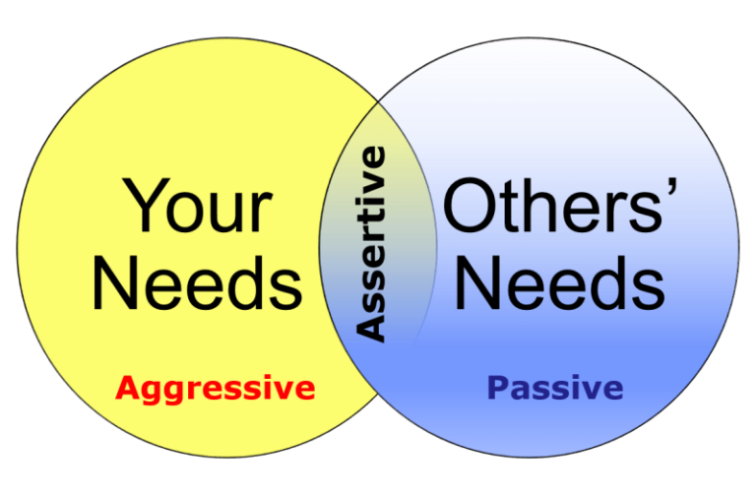

Slide 9
The Art of Assertiveness
assertive
Respecting others’ rights as well as your own
Communicating effectively, directly and with confidence.
Dealing with conflict effectively and calmly.
Handling and receiving feedback effectively.
Setting boundaries.
Focus is on behavior and problem solving instead of attacking/ignoring the person.
area of
choice
area of
no choice
aggressive
passive

Slide 10

The Art of assertiveness
Assertiveness is about self confidence, which means having a positive attitude towards yourself and others.

Slide 11
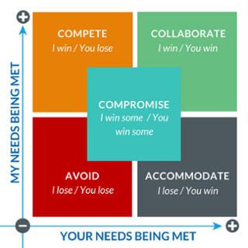

Negotiation

Slide 12
Negotiation
A dialogue between two or more people or parties intended to reach a beneficial outcome over one or more issues where a conflict exists. Negotiation is an interaction and process between entities who compromise to agree on matters of mutual interest, while optimizing their individual interests.

Slide 13
Five Strategies for Getting to Yes
Know your BATNA (best alternative to a negotiated agreement).
Separate interests from positions.
Invent options for mutual gain.
Insist on objective criteria for measuring success.
Be hard on problems and gentle with people.
From Getting To Yes: Negotiating Agreement Without Giving In, Robert Fisher and William Ury

Slide 14
POSITIONS
Things you say you want
Demands
Your solutions to a problem

Slide 15
Let’s Put it on the “board”/Chatbox
  What are some “Demands” that you communicate to the Regional Center?
  &
  What are some “Demands” that you receive from Regional Centers?

Slide 16
INTERESTS
Underlying Motivations
Concerns and Fears
Basic Human Needs
    Security
    Economic Well-being
    Sense of Belonging
    Recognition
    Control Over One’s Life

Slide 17
ACTIVE LISTENING
Builds trust between listener and speaker
Demonstrates understanding and acceptance
Encourages discussion of important issues

Slide 18
Tips for Effective Communication
Stop talking.
Ask questions when you don’t understand.
Focus your attention on the speaker’s words, ideas, and feelings.
Look at the person.
Check your emotions.
Get rid of distractions.
Share responsibility for communication.
React to the ideas, not the person.

Slide 19
Tips for Effective Communication (cont.)
Don’t argue mentally.
Listen for what is not said.
Listen to how something is said.
Avoid jumping to conclusions.
Avoid classifying the speaker.
Recognize your own prejudice.
Take an attentive body posture.
Make appropriate head nods and other movements.

Slide 20


THE ART OF THE
QUESTION

Slide 21
Ask questions that encourage communication
Tell me more about…
I am not sure I understand the part about…
Let me make sure I understood correctly…
Can you help me understand?
Can you help me get a better idea of the reason for your request?

Slide 22
The art of the question
Help me understand your view/perception of the issues.
Tell me more about how you feel about this…
What will happen if this is not worked out today?
I want to thank you for discussing such a hard issue with us and hope you can tell us more about…

Slide 23
Other questions
What would it look like for you if this matter was resolved? How would you feel?
Could you paint a picture for me of the future if this is settled/not settled?
What ideas do you have that might help solve the problem?

Slide 24
What to avoid
Avoid a question that can only be answered with a yes or no.
Avoid a question that begins with why.
Avoid asking anyone to talk about their “side.”

Slide 25
Sample questions
What might be beneficial about your/this situation not changing?
What would be the worst consequence if I/you don’t do anything?
What will you notice when he/she is truly interested in resolving this situation?
How will you know when the fight is over?
If this weren't about you/me, what would you/I be noticing?
What is your intent?

Slide 26
Sample Questions (cont.)
How will you know his/her intentions are sincere?
What needs to change in order for things to be different?
What have you been doing differently (recently) that has led to these results?
How could this be handled so that the outcome will be positive?
How will you know when you're ready for a change?
How have changes in one area affected the rest of your/my life?
Ask yourself - What is the longest period I can remember during which things were going well?

Slide 27
‘I’ Messages
When we talk about difficult situations, those about which we have strong feelings, we need to be careful about how we say things. We don’t want to make the situation worse by angering or confusing the other person. We need to be able to give important information about ourselves quickly, clearly and in a way that encourages the other person to work with us to find a solution.

Slide 28
I Message Formula –Worksheet
STEP ONE
I feel…
(Talk about your feelings)
STEP TWO
When …
(State the specific behavior)
STEP THREE
Because…
(State what happens to you)
STEP FOUR
And what I NEED is …
(Say what you need to make the situation better)

Slide 29
Some Suggestions:
Talk about yourself – about what you feel, need, want, and think.
“I have a problem, I feel angry. I need more clarity from you about meeting times. I want to be able to plan the rest of my day. I think this problem is serious.”
Begin your sentences with “I”, rather than with “you.” “I feel hurt and neglected when you don’t let me know you will be late for dinner” is more likely to be heard than,“You don’t care about me anymore. You are late on purpose to ruin dinner and hurt my feelings!”
Use neutral language, and be as specific as possible. “I can never count on you” is vague, but “I got angry when you forgot our meeting yesterday” provides specific information about how someone’s actions made you feel.

Slide 30
SMALL GROUP WORK:
IDENTIFYING INTERESTS
FROM POSITIONS
See Handout

Slide 31
CONFLICT IS INEVITABLE
BUT GROWTH IS OPTIONAL
THE MYTHS:
Conflict is bad
Sign of poor skills
Sign that you are bad
Conflict will resolve itself over time
THE FACTS:
Conflict is inevitable
May allow for growth and postive change
May improve relationships
It is not good or bad, it just is
People are not good or bad
Conflict is a part of life

Slide 32

WHY ARE PEOPLE
SO DIFFICULT?
Notes:
Confused, dissatisfied, misunderstood, marital, health, frustrated, work, promised something that wasn’t delivered, rude they can be reacting to a difficult situation.

Slide 33

ASK YOURSELF:
AM I EVER DIFFICULT?
Notes:
Is there something I am doing to cause this behavior? What is my goal here, am I being realistic? Is my reaction extreme ? Justified.

Slide 34
FORMULA FOR
SOLVING A CONFLICT

Slide 35
1. Commit to work it out
Find a good time and place to talk
Agree to try to solve the problem
Establish Ground Rules

Slide 36
2. Define the problem
Each person says what happened and how he/she feels
Use active listening and “I” messages
Focus on needs

Slide 37
3. Brainstorm solutions
Suggest many ways to address the issue
Do not judge the suggestions

Slide 38
4. Choose a solution & make an action plan
Consider all options; look at possible outcomes
Select a solution that everyone agrees to
Decide the specifics (i.e., Who? What? Where? When? How?)

Slide 39
THINGS I SHOULD BE READY TO
PUT ON THE TABLE
_{My Interests} What I really care about. My wants, needs, concerns, hopes, and fears | _{Options} Possible agreements that we might reach | _{Legitimacy} External standards or precedents that might convince one or both of us that a proposed agreement is fair | _{Their Interests} _{What I think} _{they} really care about: their wants, concerns, hopes, and fears
My Walk-Away Alternative
What can I do if I walk away without agreement? Which is the best? What would I really do?
Commitment
If we reach agreement, we commit to some option

Slide 40
Small Group Work
Utilize the Interest-Based Prep Sheet “Prepare for a Challenging Meeting between a Parent and Regional Center”
(See Case)

Slide 41
Small Group Work
Thinking about today’s training, what are 2-3 skills/tools that you can begin using right away in your communications with Regional Center, medical insurance or an agency that your child attends?

Slide 42
Tips For E-mailing Regional
Center and Agencies
Less is more
Use email for confirming and summary
Use neutral language
Not meant to replace a phone or in-person meeting

Slide 43
Three Step Approach to Avoiding
E-mail Conflict
Step One
    E-mail is sent out
Step Two
    E-mail is received and from the reply, it seems there is at miscommunication (something doesn’t “feel right”)
Step Three
    Pick up the phone and talk about the content of the e-mail (perhaps consider having a face-to face meeting)

Slide 44
Purchin Consulting
ADR Services Include:
                Program Development
                Mediation
                Training
                Coaching
                Meeting
                Facilitation
We Are Advocates for the Process Only

Slide 45
Keep In Touch!
Presented by:
Marc Purchin
mpurchin@purchinconsulting.com
(310)202-1155

